Slide 3
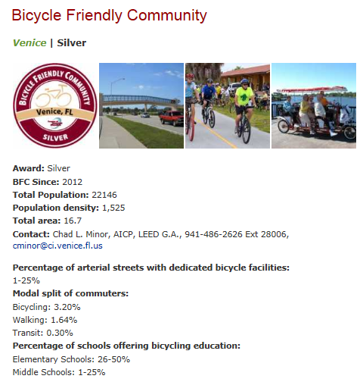

Slide 4
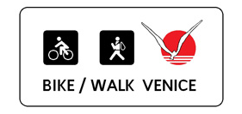

Slide 5
The Five E’s of a BFC
ENGINEERING
EDUCATION
ENCOURAGEMENT
ENFORCEMENT
EVALUATION & PLANNING

Slide 6
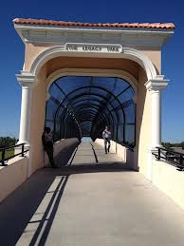
ENGINEERING

Slide 7
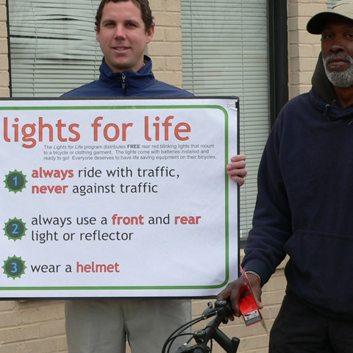
EDUCATION

Slide 8
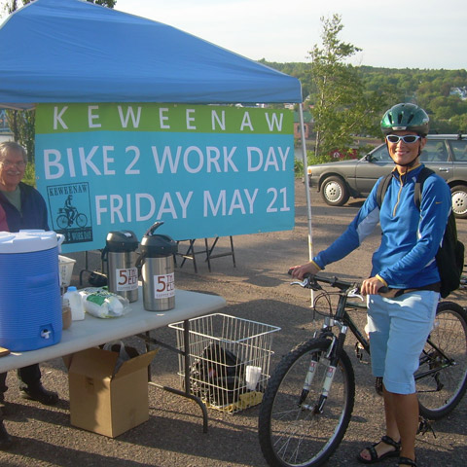
ENCOURAGEMENT

Slide 9
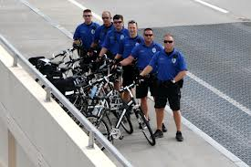
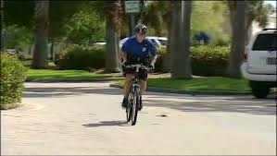
ENFORCEMENT

Slide 10
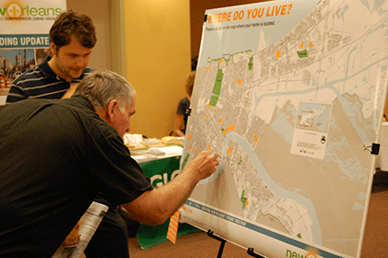
EVALUATION & PLANNING

Slide 11
Bicycle Friendly Communities
Where are they?
How many of them are there?

Slide 12
Platinum - 3

Slide 13
Gold - 16
Breckenridge CO
Corvallis OR
Durango CO
Eugene OR
Fort Collins CO
Jackson and Teton County WY
Madison WI
Minneapolis MN
Missoula MT
Palo Alto CA
San Francisco CA
Scottsdale AZ
Seattle WA
Stanford University CA
Steamboat Springs CO
Tucson & East Pima Region AZ

Slide 14
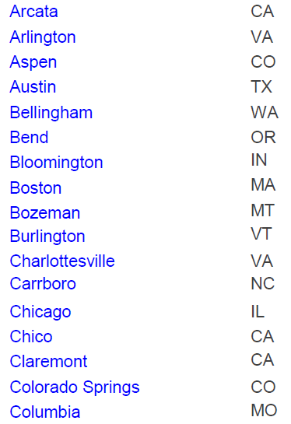
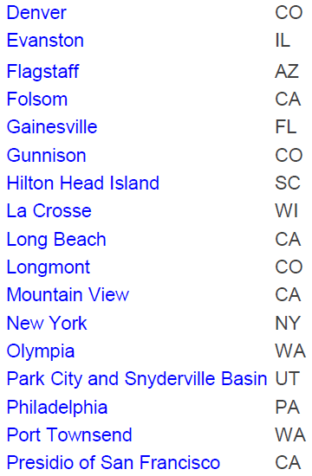
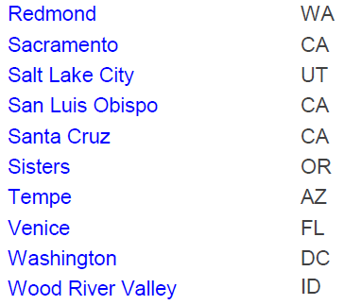
Silver - 44
Bronze - 200

Slide 15
http://ht5000.jimdo.com/venice-bfc-feedback/

Slide 16
Riding on our Trails
Legacy Trail
Venetian Waterway Trail

Slide 17
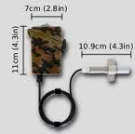
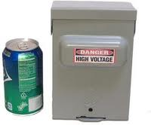
Counting Riders on the Trails
Number of trail users on the LT/VWP

Slide 18
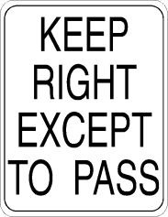
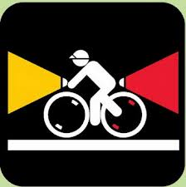
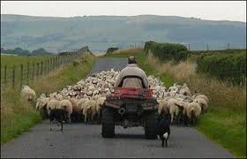
Rules for Sharing the Trail
Courtesy
Announce when passing
Yield when entering and crossing
Keep right
Pass on left
Be predictable
Use lights at night
Do not block the trail

Slide 19
Riding on the Roads Drive Your Bike Like a Car, Only Slower. Cyclists fare best when they act and are treated as drivers of vehicles.

Slide 20
The Five Layers of Bicycling Safety

Slide 21
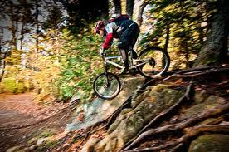
Layer 1: Control Your Bicycle
(Don’t fall or collide with others)
If you can skillfully control your bike by starting, stopping, and turning properly, you will not fall down all by yourself or run into others. Do this and you reduce your risk of injury by 50%. To ride in groups, a cyclist must have good bike handling skills.

Slide 22
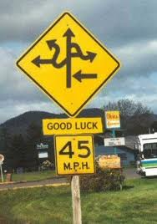
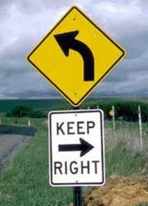
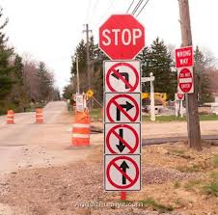
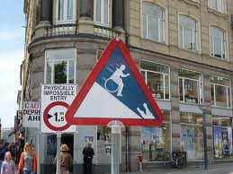
Layer 2: Follow the Rules
(Don’t cause traffic accidents)
Follow traffic laws, obey signs and signals, use headlights and taillights at night, and use the correct lanes for turns and through movements and you won’t cause a collision with a motorist. About half of cyclist/motorist crashes are caused by cyclists who violate the basic rules of the road. Combine Layers 1 and 2 and you cut about 75% of your injury risk

Slide 23
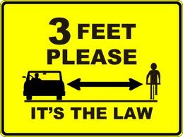

Slide 24
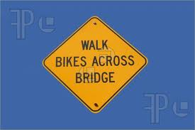
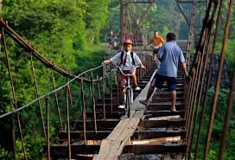

Slide 25
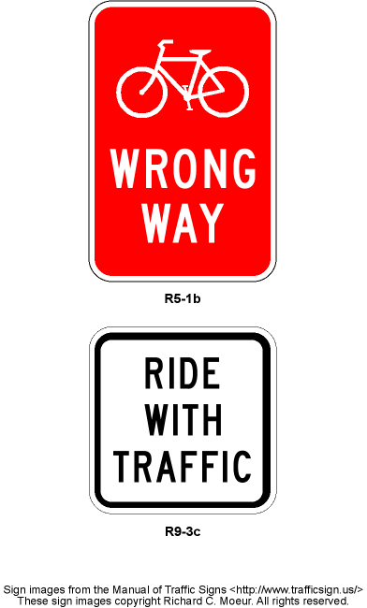
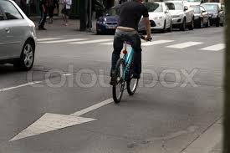
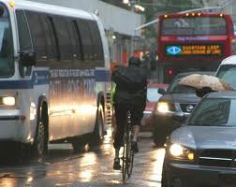
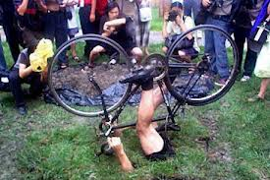

Slide 26
Layer 3: Lane Positioning
(Discourage other driver’s mistakes)
Knowing when to use the full lane or to share a lane is something few cyclists fully understand. Your position in a lane is the best way to make yourself conspicuous, to tell drivers what you are doing, and to discourage them from making unsafe movements.
Combine Layers 1, 2 and 3 and you cut out about 99% of all potential crashes.

Slide 27
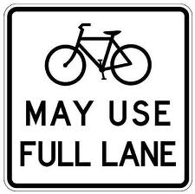
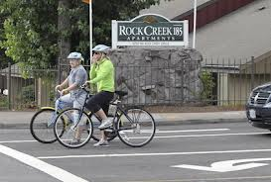
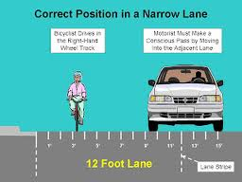
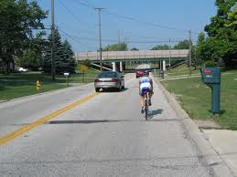
Layer 3: Lane Positioning

Slide 28
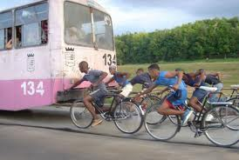
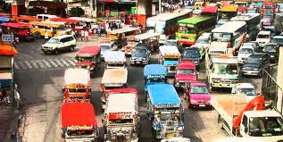
Layer 4: Hazard Avoidance
(Avoid the other driver’s mistakes)
There are evasive maneuvers you should know that can help you avoid major motorist mistakes or dodge obstacles. Knowing how to stop and turn quickly helps you avoid motorist mistakes that aren’t discouraged by lane positioning. These skills are not instinctive and must be taught.

Slide 29
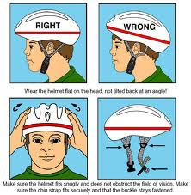
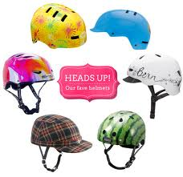
Layer 5: Passive Safety
(Protection when all else fails)
This is actually the least effective layer. Helmets and gloves protect your most vulnerable body parts as a last resort in case of the very rare failure of Layers 1 through 4, but they do nothing to help you avoid crashes.

Slide 30
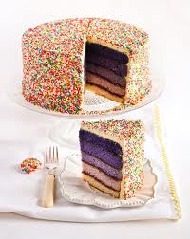
The Five Layers of Bicycling Safety
Control Your Bicycle – 50%
Follow the Rules – 25%
Lane Positioning – 24%
Hazard Avoidance – 1%
Passive Safety

Slide 31
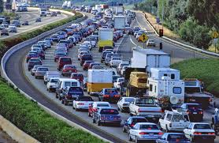
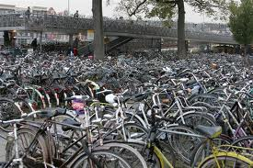
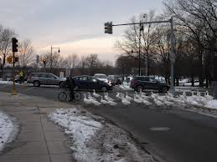
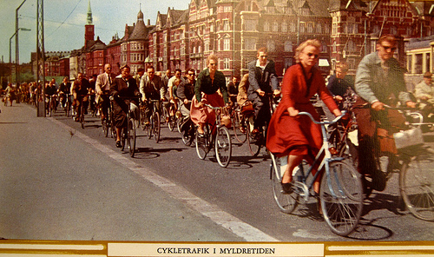
How to handle traffic situations that you may encounter.

Slide 32
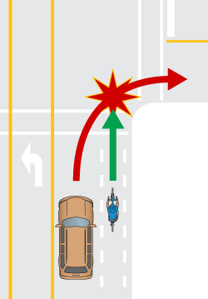
Overtaking Right-hook: Motorist passes and turns right in front of cyclist.
Savvy Cycling: Keep ‘em behind you. Ride farther left, they’ll wait to turn. Move to the left side of the lane before an intersection with a high volume of right-turning traffic and before a lane splits into a straight-thru and right-turn lane.

Slide 33
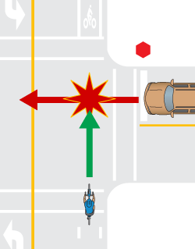
Drive-out:
Motorist pulls out from side street into cyclist’s path.
Savvy Cycling: Ride farther left, they are more likely to see you if you are in the traffic lane where they are looking. Stay out of shoulders and undesignated areas to the right of the edge-line, especially where there are a lot of driveways and cross-streets. Even avoid marked bike lanes if they reduce your visibility to crossing traffic.

Slide 34
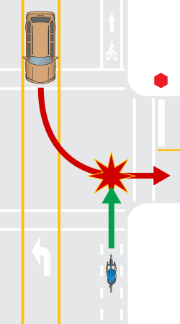
Left-cross:
Motorist turns left into, or front of, cyclist.
Savvy Cycling: Ride farther left, they are focused on the oncoming traffic lane and a leftward position indicates higher speed. Keep pedaling, if you coast, they think you are yielding to them. Be prepared to execute an emergency maneuver.

Slide 35
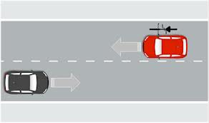
Side-swipe:
Motorist tries to squeeze between cyclist and centerline, median or oncoming traffic.
Savvy Cycling: Ride farther left to discourage same-lane passing in narrow lanes.. Remember, you are not choosing a lane position to accommodate small cars. You must ride in a consistent, predictable position while maintaining your focus forward.

Slide 36
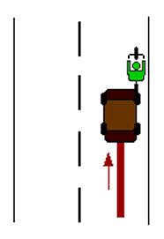
Rear-end:
Motorist runs smack into the back of a cyclist. This is a rare type of collision and usually involves darkness, lack of proper bike lights and alcohol.
Savvy Cycling: Make yourself relevant and visible. Always use lights at night. In low light, high visibility colors are helpful. Reflective is helpful at night.

Slide 37
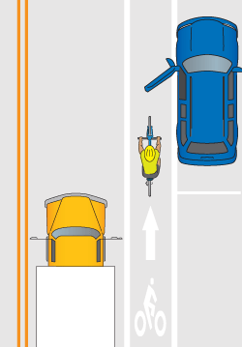
The Door Prize:
Driver opens the door of a parked car into the cyclist. This can be a deadly collision.
Savvy Cycling: Stay at least 5 feet from parked cars - no matter where the bike lane is.

Slide 38
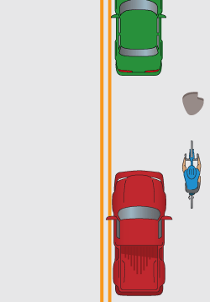
Pothole Plunge:
Cyclist crashes because she can’t avoid a surface hazard due to overtaking motorists.
Savvy Cycling: Ride farther left (are you seeing a theme here?), most hazards are on the right edge of the road. Claiming the lane gives you the whole lane to avoid hazards without having to merge or worry about overtaking motorists.

Slide 39
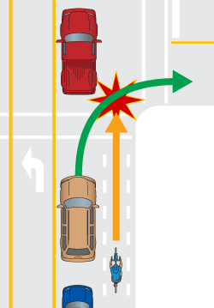
Passing-on-the-Right-hook:
Cyclist passes slow-moving cars on the right and car turns right into cyclist. This is a common bike lane crash.
Savvy Cycling: Don’t pass slower/stopped traffic on the right. Use extreme caution if you need to pass a queue of traffic. You can’t rely on motorists to use their turn signals or to look before turning or merging into a bike lane. Merge left into the traffic lane if you are moving the same speed as traffic.

Slide 40
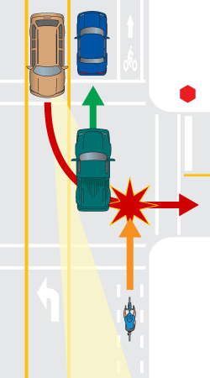
Left-cross in the Blind Spot:
Bike lanes can contribute to this kind of crash.
Savvy Cycling: Be aware that moving or stopped cars to the left of you obscure your visibility to traffic in the oncoming lane. If you choose to pass a queue of stopped traffic on the right (with or without a bike lane), drive slowly and carefully, stop at gaps in the traffic to your left and expect crossing conflicts.

Slide 41
Crosswalk/Sidewalk Slam:
Car turns into cyclist riding in crosswalk or across a driveway on the sidewalk.
Savvy Cycling: Don’t ride on the sidewalk and avoid sidepaths. Motorists are focused on the travel lanes and typically "tune out" activity on the margins.

Slide 42
Wrong-way Wallop:
Cyclist riding the wrong way gets hit by crossing or turning motorist.
Savvy Cycling: Ride with the flow of traffic. Motorists don’t look for vehicles driving the wrong way

Slide 43
Scofflaw Smack-down:
Cyclist runs a stop sign or red light and gets hit.
Savvy Cycling: Follow the rules. Traffic control devices are for ALL vehicles, including bicycles.

Slide 44
Ninja Knock-out:
Any of the common crashes involving a cyclist without lights at night.
Savvy Cycling: You are required by law to have a white headlight and red tail light and rear reflector on your bike when operating in the dark. Make sure you are visible. Don't skimp on lights and retro-reflective materials

Slide 45
Good Places to Ride
Legacy Trail/ Venetian Waterway Trail
Venice Island Loop
Honore Loop in Palmer Ranch
Casey Key
Manasota Key
Edmonson/Border Road to Forbes Trail
Carlton Reserve/Deer Prairie Creek

Slide 46
Venice Island Loop

Slide 48
Edmonson/Border Road to Forbes Trail Loop

Slide 50
Deer Prairie Creek Preserve

Slide 51
Group Rides
Coastal Cruisers Bike Club
Sarasota Manatee Bike Club
Real Bikes Group Rides
Organized Events
Sharky’s Ride the Beaches
Tour de Parks

